Slide 1
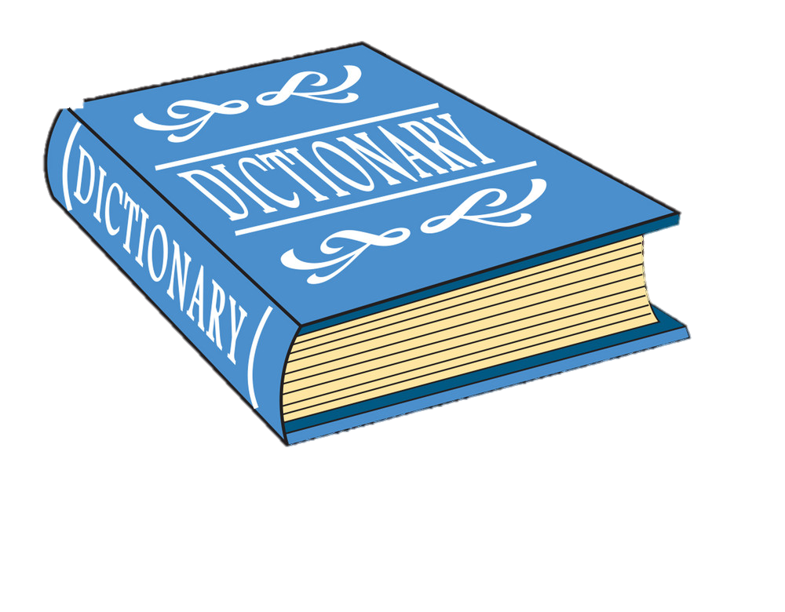
DICTIONARY GUI
Akshat Joshi (13)
Ankit Upadhyay (18)
Priyanshu Bhatt (138)
(BTECH CSE III)
(Section –B)

Slide 2
PYTHON DICTIONARY
Definition- It is a collection of keys values, used to store data values like a map, which, unlike other data types which hold only a single value as an element.
Python dictionaries are also known as associative arrays or hash(#) tables.
Dictionaries consists of pairs(items) of keys and their corresponding values.

Slide 3
What is Python
Python is an interpreted, object-oriented, high-level programming language with dynamic semantics. Its high-level built in data structures, combined with dynamic typing and dynamic binding, make it very attractive for Rapid Application Development, as well as for use as a scripting or glue language to connect existing components together.

Slide 4
Important point of dictionary
The items are separated by commas, and the whole thing is enclosed in curly braces { }.
An empty dictionary without any items is written with just two curly
braces, like this { }.
The values of a dictionary can be of any type, but the keys must be an mutable data type such as strings, numbers, or tuples.
Each key is separated from its value by a colon (:).

Slide 5
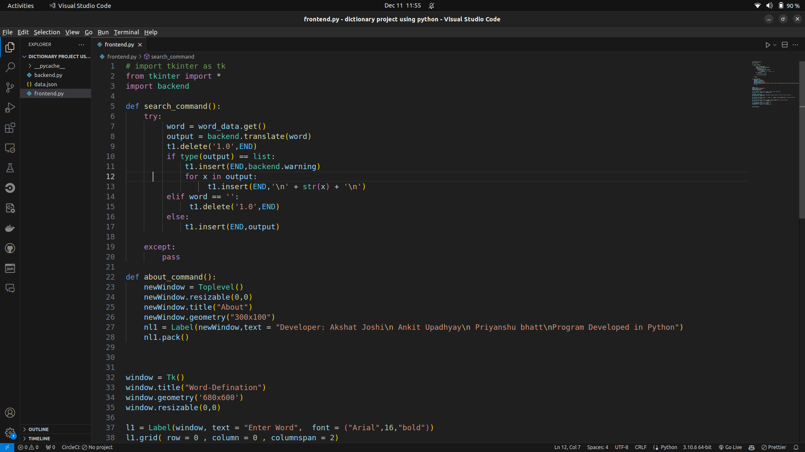
Frontend Code

Slide 6
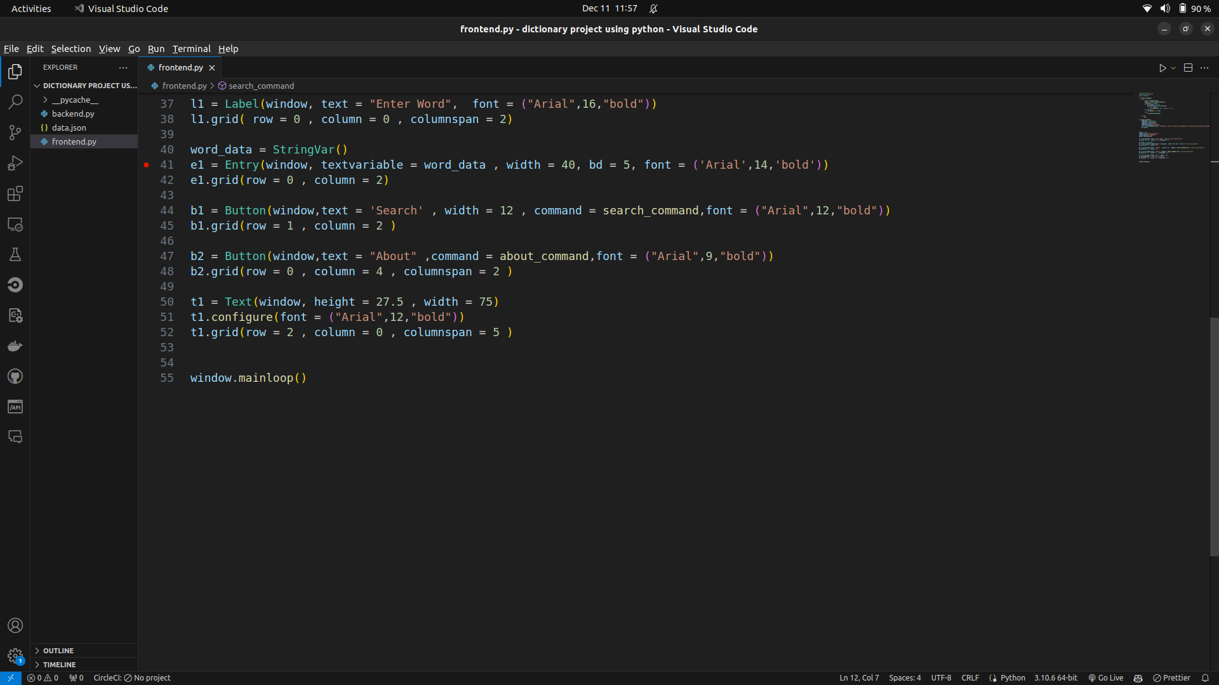

Slide 7
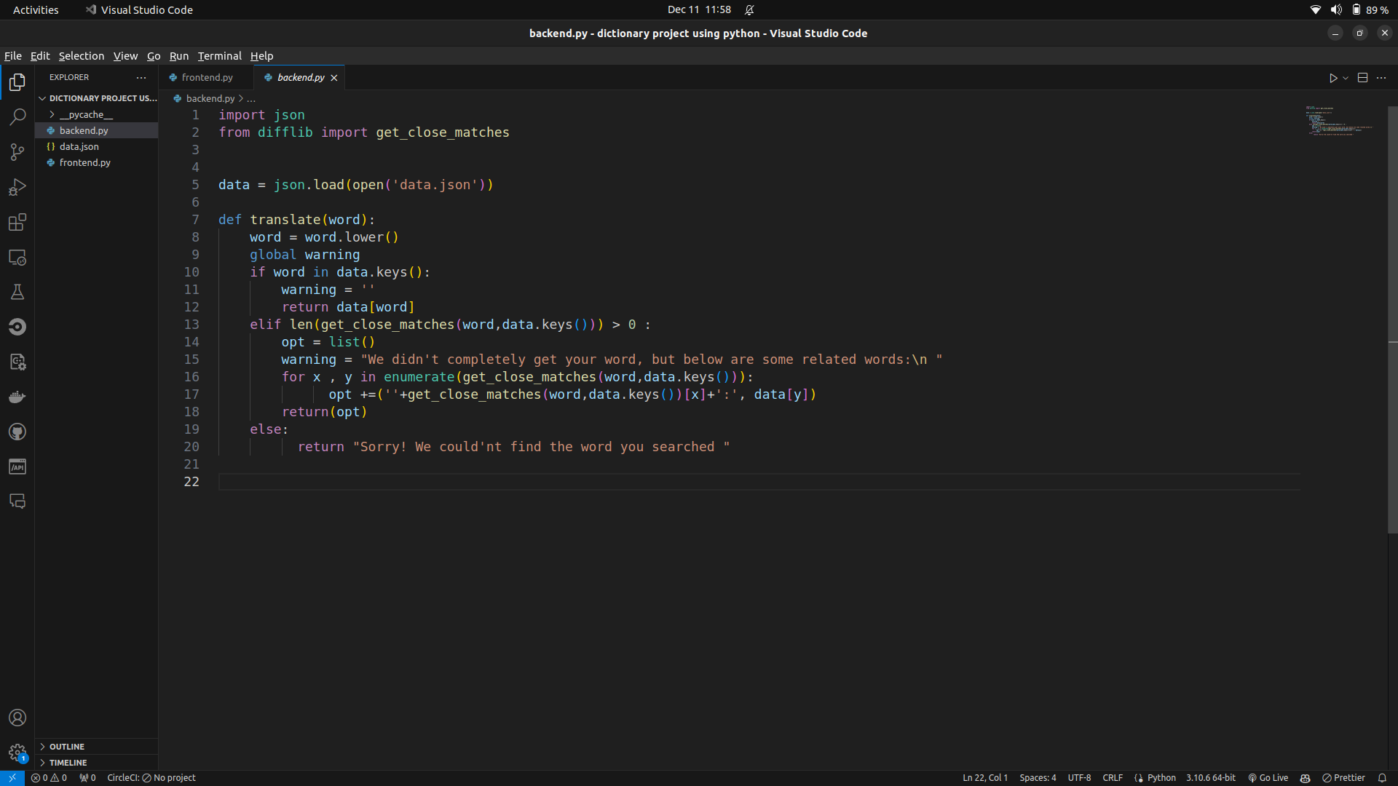
“
Backend code
”

Slide 8
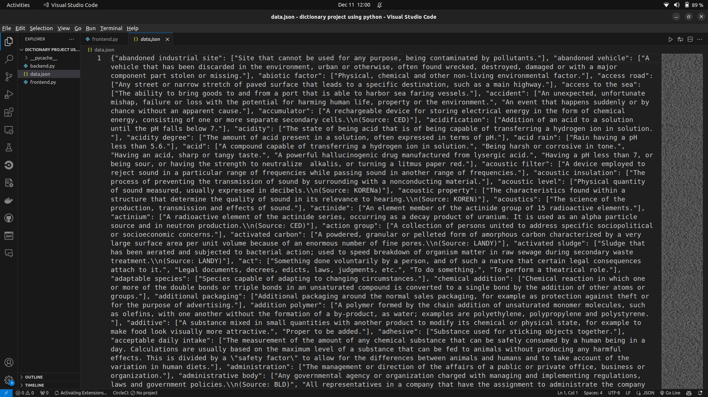
Data json

Slide 9
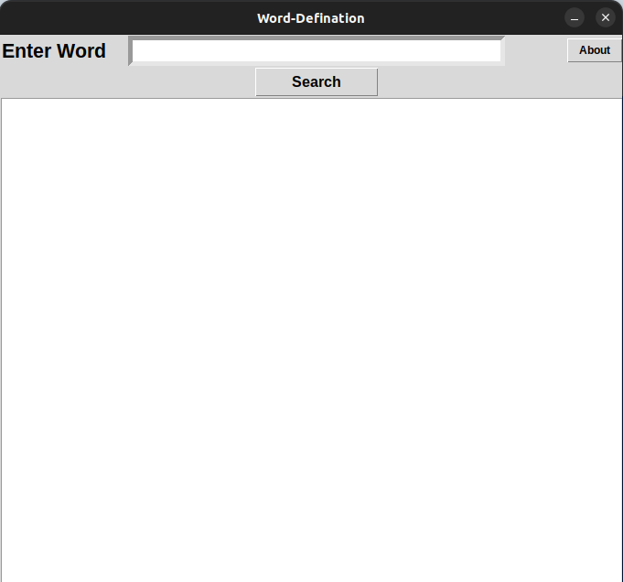
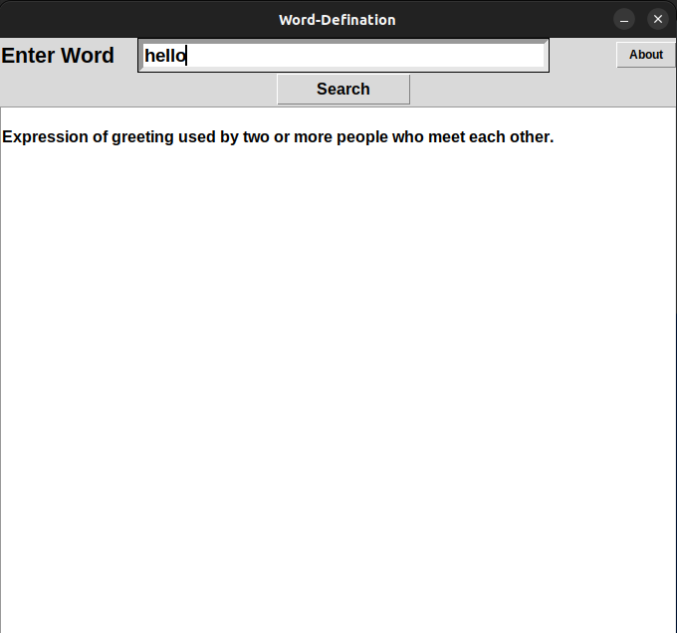
Execute

Slide 10
Thank YOU

